Slide 1


Secure Coding for Android

Slide 2

Security is Important
Over one billion smartphones were sold last year
It is estimated that 64% of Americans own a smartphone
People are storing lots of personal data on their phone. Many people have corporate data on their phone
Smartphones are a big target
Notes:
Security has a big impact on todays smart phones it said there were over one billion smart phones sold last year and over ^4% of thos phone sold belong to Americans. Since technology is advancing so quickly particuallry mobile devices which are beginning to hold more and more information and sensitive information things like username and passwords, photos, notes,contacts. Etc…. Due to them begin so advanced they are becoming a primary target for hackers in todays society.

Slide 3
Cause of the Problem
Most vulnerabilities in applications are the result of poor programming practices
In many cases, the application developer failed to take adequate safeguards
As application developers, you can fix the problem
Notes:
Most security vulnerabilities and other issues are the result of a develops mistake/ bad programming. As developers we are expected to fix any problem pertaining to your own work

Slide 4
Getting It Right the First Time
Eliminating vulnerabilities during development can reduce cost compared with making repairs afterwards
Following good coding and development standards can significantly improve your app's resistance to attack
Notes:
The easiest way to avoid problems such as sucerity vulnerablilities is to simply code it right the first time. This task is nearly impossible but meaning get close to 100% as you possible can before you release your application

Slide 5


CERT
CERT is part of the Software Engineering Institute, which is based at Carnegie Mellon University
They work with the Department of Homeland Security's United States Computer Emergency Readiness Team (US-CERT)
US-CERT leads efforts to improve the Nation's cybersecurity posture

Slide 6
Secure Coding Standards
CERT has developed a list of secure coding practices for languages and platforms
Rules and Guidelines for Java Secure Coding for Android
https://www.securecoding.cert.org/confluence/pages/viewpage.action?pageId=111509535
CERT rates their coding rules according to severity, likelihood and remediation cost

Slide 7
Input Validation
Making sure that input data is reasonable is the most important thing you can do to protect your app against exploit
Make sure that numbers are not too big or too small
(e.g., integer overflow attack)
Make sure strings are not empty or too long
E.g., buffer overflow attack
Notes:
Input validation is important for securtity purposes because when taking in input you must consider what the user may enter in and if they types do not match it could leave a vulnerable spot in your application. Input validation should be taken seriously making sure that all input goes through a vigourous process in order to establish a secure application

Slide 8
White Listing
It is usually best to validate that the data meets a criteria than to measure that it doesn't meet a criteria
You can often generate a pattern
Notes:
There are to ways you can validate input white listing being one of them. White listing is comparing input to a a specific criteria in order to see if the input is valid. This us said to be easier than black listing which is comparing input to all wrong patterns

Slide 9
Android Secure Coding Standard
CERT published 27 rules and guidelines for Java program development for Android platform
Some of these rules are still under construction
Notes:
Cert published 27 rules 10 rules are complete and I personally implemented 9 of them.

Slide 10
Android Secure Coding Standard
The following secure coding rules are introduced here
(DRD00) Do not store sensitive information on external storage (SD card) unless encrypted first
(DRD01-X) Limit the accessibility of an app’s sensitive content provider .
(DRD03-J) Do not Broadcast sensitive information using an implicit intent.
(DRD04-J) Do not log sensitive information
(DRD08_J) Always canonicalize a URL received by a content provider
(DRD09-J) Restrict access to sensitive activities
(DRD10-J) Do not release apps that are debuggable
(DRD15-J) Consider privacy concerns when using Geolocation API
(DRD19-J) Properly verify server certificates on SSL/TLS
Notes:
Here is a list of the rules I will be discussing today

Slide 11
DRD00: External Storage
DRD00: Do not store sensitive information on external storage (SD card) unless encrypted
Files written to external storage can be modified or read by
other applications installed on the device
any devices such as PC
Rule | Severity | Likelihood | Remediation Cost
DRD00 | medium | probable | medium
Notes:
We have your DRD00 which states do not store sensitive information on external storages without first being encrypted. The reasoning for this is because you never know who will be accesing your external hardrive so leaving sensitive information that is unencrypted can be vulnerable for hackers

Slide 12
DRD00: Recommendation
Store sensitive data on the internal file system
Encrypt sensitive data before writing to a file
compliant code:
fos = openFileOutput(filnam, Context.MODE_PRIVATE);
fos.write(string.getBytes());
fos.close();
OpenFileOutput() method will create file in an internal application data directory with private mode so that other applications cannot access the file

Slide 13
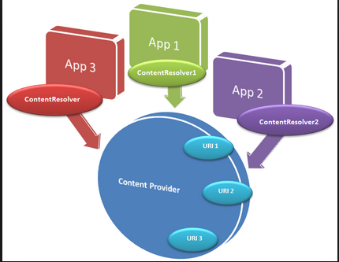
DRD01-X Sensitive Content Provider
DRD01-X Limit the accessibility of an app’s sensitive content provider
ContentProvider class provides a mechanism for managing and sharing data with other application.
Rule | Severity | Likelihood | Remediation Cost
DRD01-X | medium | probable | low
Notes:
This is your DRD01 which states limit the accessibility to your sensitive content providers meaning restrict sensitive data transferring between application.

Slide 14
DRD01-X Recommendation
By specifying the android:exported attribute in the AndroidManifest.xml file, a content provider is made public or private to other applications.
android:exported="true“ (content provider is public, i.e., all application can access the content provider)
android:exported=“false“ (content provider is private, only application that has implemented the content provider can access the content provider)
For Android applications before API Level 16, you need to explicitly specify android:exported="false“ to limit access to sensitive content provider.
Notes:
The android:exported attribute controls when content providers are allowed to share data. When setting it equal to true you have set it to be public allowing all data transferring betweem that application content provider and any content resolver implemented. When setting it to false you have set it equal to false which is no longer allowing application to access the information.

Slide 15
DRD03-J Do not broadcast sensitive information using an implicit intent
Android applications' core components such as activities, services, and broadcast receivers are activated through messages, called intents.
Applications can use broadcast to send messages to multiple applications (i.e., notification of events to an indefinite number of apps).
Application can receive a broadcast intent sent by the system.
Broadcasts can be vulnerable to passive eavesdropping or active denial of service attacks.
Rule | Severity | Likelihood | Remediation Cost
DRD03-J | medium | probable | medium
Notes:
DRD 03 states do not broadcast sensitive information using an implicit intent. When sending a broadcast globally you have left yourself open to passive eavesdrooping and active denial of service attacks. Eaves dropping is the unauthorized listening in on phone calls, text messaging, fax transmissions., active denial of service attacks are attempts to block you form using certain services like your internet or someone flooding your email with spam blocking you from reciving or sending any new emails.

Slide 16
Broadcast and receive Intents
To broadcast an intent it is passed to Context.sendBroadcast() to be transmitted
Interested receivers can receive the intent, dynamically registering themselves by calling Context.registerReceiver()with the specified intentFilter as an argument.
Alternatively, receivers can be statically registered by defining the <receiver> tag in the AndroidManifest.xml file.

Slide 17
Threats of Broadcasting using Implicit Intent -1
Eavesdropping
Malicious Broadcast Receiver could create an Intent Filter that lists all possible actions, data, and categories.
there is no indication to the sender or user that the broadcast has been read
Denial of Service
For ordered broadcast, a malicious app could register itself with a high priority to receive the broadcast first
Then it could either cancel the broadcast preventing it from being propagated further
Or inject a malicious data result into the broadcast that is ultimately returned to the sender.

Slide 18
Threats of Broadcasting using Implicit Intent -2
Activity and Service Hijacking
A malicious activity or service can intercept an implicit intent and be started in place of the intended activity or service.
This could result in the interception of data or in a denial of service.

Slide 19
DRD03-J Recommendation
Non Compliant code
public class ServerService extends Service {
private void d() {
Intent v1 = new Intent();
v1.setAction("com.sample.action.server");
v1.putExtra(“userId", v0.uid);
v1.putExtra(“password", v0.psw);
}
}
this.sendBroadcast(v1);
}
Compliant code: Use LocalBroadcastManager
other apps cannot received the broadcast message
Intent intent = new Intent("my-sensitive-event");
intent.putExtra("event", "this is a test event");
LocalBroadcastManager.getInstance(this).sendBroadcast(intent);
Notes:
The local broadcast manager sends the information via locally within the current process only allowing the current active app to send and receive the information

Slide 20
DRD04-J: Do not log the sensitive information
Android provides capabilities for an app to output logging information and obtain log output.
Applications can log output using the android.util.Log class.
To obtain log output, applications can execute the logcat command.
It is important that applications do not send sensitive information to log output.
Non compliant code:
Log.d(TAG, "Login Success! access_token="
+ getAccessToken() + " expires="
+ getAccessExpires());
Rule | Severity | Likelihood | Remediation Cost
DRD04-J | medium | probable | low
Notes:
DRD 04 which states do not log sesntive information because any malicious application that has the READ_LOGS permission has access to any logged information and can extract the data if necessary.

Slide 21
DRD08-J: Canonicalize a URL
DRD08-J: Always canonicalize a URL received by a content provider
ContentProvider.openFile() can allow another app to access your app's data
Depending on the implementation of ContentProvider, use of the method can lead to a directory traversal vulnerability
Rule | Severity | Likelihood | Remediation Cost
DRD08-J | high | probable | low

Slide 22
DRD08-J: Recommendation
When exchanging a file through a content provider, the path should be canonicalized before it is used
i.e., fully resolves the argument and constructs a cononicalized path
For example: /img/../etc/passwd resoves to /etc/passwd
compliant code:
String DIR = localFile.getAbsolutePath();
String decodedUriString = Uri.decode(myUri.toString());
File file = new File(DIR, Uri.parse(decodedUriString).getLastPathSegment());
if (file.getCanonicalPath().indexOf(localFile.getCanonicalPath()) != 0)
throw new IllegalArgumentException(); // the path is canonicalized, and checked that it is included in the DIR

Slide 23
DRD09: Restrict Access to Activities
DRD09: Restrict access to sensitive activities
Declaring an intent filter for an activity in AndroidManifest.xml means the activity may be exported to other apps
If the activity is intended solely for the internal use of the app and an intent filter is declared, then any other apps, including malware, can activate the activity for unintended use
Rule | Severity | Likelihood | Remediation Cost
DRD09 | high | probable | medium

Slide 24
DRD09: Recommendation
Declaring android:exported="false" for an activity tag, restricts the activity to only accept intents from within the same app or from an app with the same user ID
compliant code:
in the AndroidManifest.xml
<activity … android:exported="false">
</activity>

Slide 25
DRD10-X: Debuggable
DRD10-X: Do not release apps that are debuggable
When the attribute android:debuggable is set to true in the manifest, the app can be debugged
With the attribute set to true, users can debug the app even without access to its source code
Rule | Severity | Likelihood | Remediation Cost
DRD010-X | high | probable | low

Slide 26
DRD10-X: Recommendation
By default this attribute is disabled (i.e. set to false), but it may be set to true to help with debugging during development of the app
some development environments automatically set android:debuggable to true for incremental or debugging builds but set it to false for release builds
App should never be released with this attribute set to true

Slide 27
DRD15-J: Privacy of Geolocation
DRD15-J: Consider privacy concerns when using Geolocation API
The Geolocation API, which is specified by World Wide Web Consortium (W3C), enables web browsers to access geographical location
In the specification, it is prohibited that user agents send location information to web sites without obtaining permission from the user
Rule | Severity | Likelihood | Remediation Cost
DRD18 | low | probable | medium

Slide 28
Enabling Location
To enable geolocation using the WebView class, the following permissions and the webkit package are necessary:
permissions
android.permission.ACCESS_FINE_LOCATION
android.permission.ACCESS_COARSE_LOCATION
android.permission.INTERNET
webkit package
WebSettings#setGeolocationEnabled(true)
WebChromeClient#onGeolocationPermissionsShowPrompt()

Slide 29
DRD15-J: Recommendation
A conforming implementation must acquire permission through a user interface before sending the user's geolocation to the web site

Slide 30
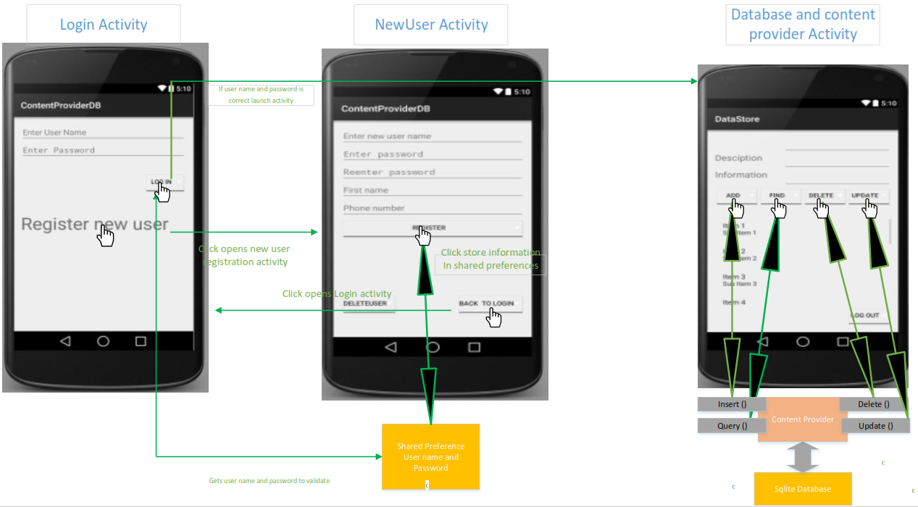
Hands on Exercise
You will be given a vulnerable android Application
VulnerableApp

Slide 31
Hands on Exercise(con’t)
The VulnerbaleApp Violates Rules:
(DRD00) Do not store sensitive information on external storage (SD card) unless encrypted first
(DRD01-X) Limit the accessibility of an app’s sensitive content provider .
(DRD03-J) Do not Broadcast sensitive information using an implicit intent.
(DRD04-J) Do not log sensitive information
(DRD09-J) Restrict access to sensitive activities
(DRD10-J) Do not release apps that are debuggable

Slide 32
Tools Used
adb: Android Debug Bridge
a command line tool that helps in communicate with an emulator instance or connected Android-powered device.
It is a client-server program.
Dozer : open source dynamic analysis tool
Dozer can be used to assume the role of an Android app and interact with other application.
Could be used remotely exploit Android devices
SACHv2:Secure Android Coding Helper
It scans android source code for violation of CERT Secure Coding Rules
aapt: The Android Asset Packaging Tool
It can be used to list, add and remove files in an APK file, package resources.

Slide 33
Hands on Exercise: Five Parts
Part I: Scanning the VulnerableApp source code for vulnerabilities using SACHv2
Part II: Exploit Debuggable Program that Logs sensitive information
Part III: Exploit public Content Provider and public Activities
Part IV: Receive Global broadcast and Exploit Unencrypted information on external storage
Part V: Scanning fixed VulnerableApp source code using SACHv2

Slide 34
Part I Scanning the VulnerableApp source code with SACHv2
Tools:
SACHv2
Procedure:
Locate AndroidManifest.xml, .properties file, java source code
Run SACHv2
Select three inputs from above
Anaylze
View Report

Slide 35
Part II Exploit debuggable Program that logs sensitive information
Tools:
Adb
Drozer
Procedure:
Start Android Studio
Run Emulator
Install VulnerableApp
Run Drozer to debug VulnerableApp
Retrieve Log information
Fix code

Slide 36
Part III: Exploit public Content Provider and public Activities
Tools:
Adb, aapt
Procedure:
Start Android Studio
Run Emulator
Install VulnerableApp
Access Content Provider to retrieve database Information
Access Activity and launch the activity
Fix code

Slide 37
Part IV: Receive Global broadcast and Exploit information on external storage
Tools:
Adb
Procedure:
Start Android Studio
Run Emulator
Install VulnerableApp
Retrieve information sent via sendBroadcast()
Retrieve Information on external storage
Fix code

Slide 38
Part V: Scanning fixed VulnerableApp source code
Tools:
SACHv2
Procedure:
Locate AndroidManifest.xml, .properties file, java source code
Run SACHv2
Select three inputs from above
Anaylze
View Report

